Slide 1
Beer Ratings Analysis & Prediction
MSDS 6306 Case study 2
Bhuvana Adur Kannan
Christopher Ballenger
Selwyn Samuel

Slide 2
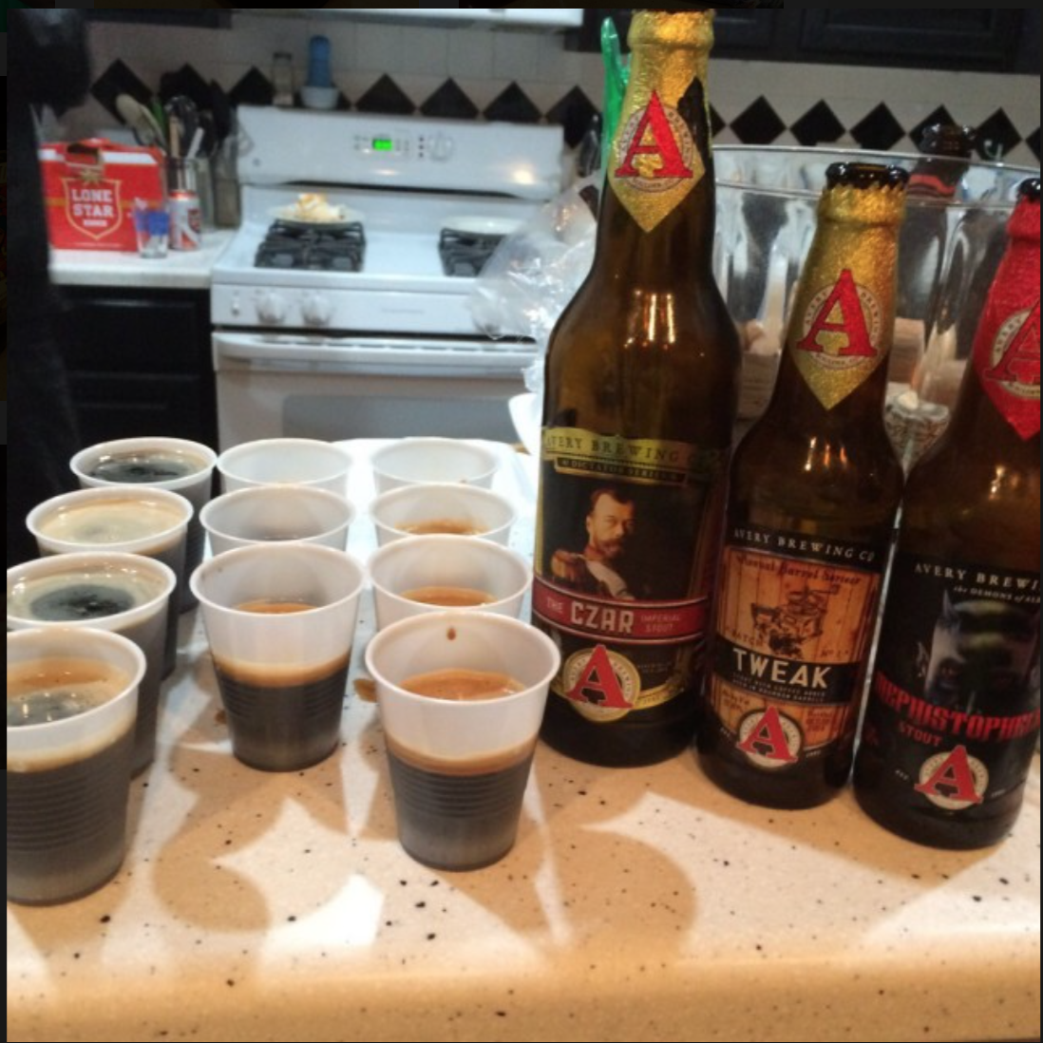
Outline
Project Goals
Data Gathering
Feature Selection
Modeling
Results

Slide 3
Project Goals
Data Science Project Life Cycle
Apply Statistics lessons from MSDS 6371
Problem analysis & Identification of tests
Learn new technologies
APIs, Web Scraping, ML algorithms, H₂O Platform
Learn the model and not Perfect the model
Run evaluations on the model
Report statistics on the model

Slide 4
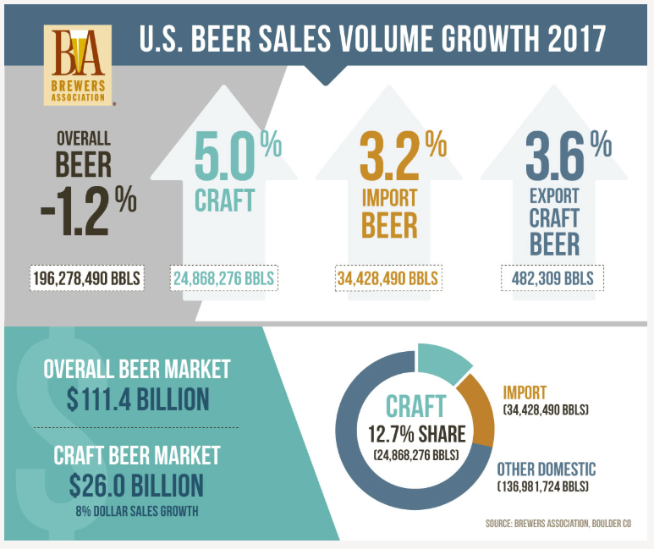
Beer Industry
Trend
Overall beer sales down 1%
Craft & Import beer sales up 8%
23% of overall beer sales
Beer drinkers are turning into beer enthusiasts & beer connoisseurs
For me, it equates to a sense of adventure – collecting sensory experiences through flavor profiles like Indiana Jones collects priceless artifacts. The excitement of a satisfying brew, falling into off-flavors – these experiences belong in the museum of your mind!
- Katy Tilley (DESTIHL Brewery Ambassador)
Source: https://www.brewersassociation.org

Slide 5
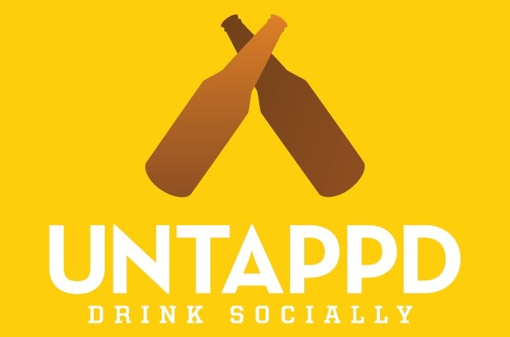
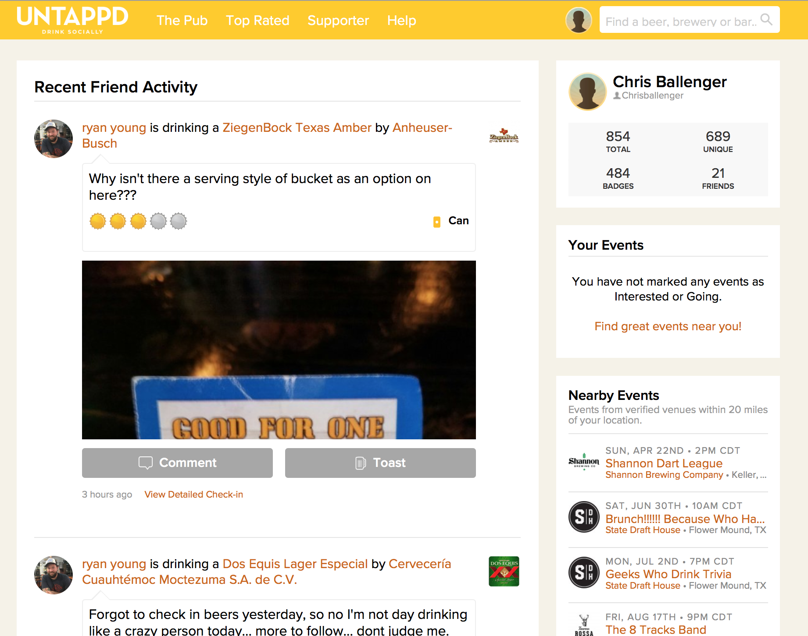
Untappd – Drink Socially
Allows users to rate Beers, Meads, and Ciders (check-ins) on a scale of 0 – 5 (0.25 increments)
Users can see what their friends are drinking and comment on their check-ins
While rating, users can select where they are consuming the beer, flavors they tasted, how it was served

Slide 6
Questions we would like to answer
Is there a bias in the way beer enthusiasts rate a beer at a brewery location and other locations?
When a beer enthusiast/connoisseur walks into a brewery can we recommend a beer that he/she would like based on their past ratings profile?

Slide 7
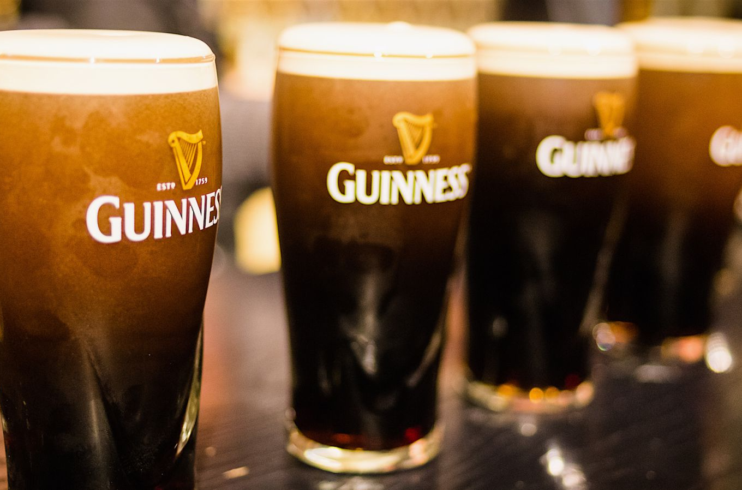
1. Is beer really better at the brewery?

Slide 8
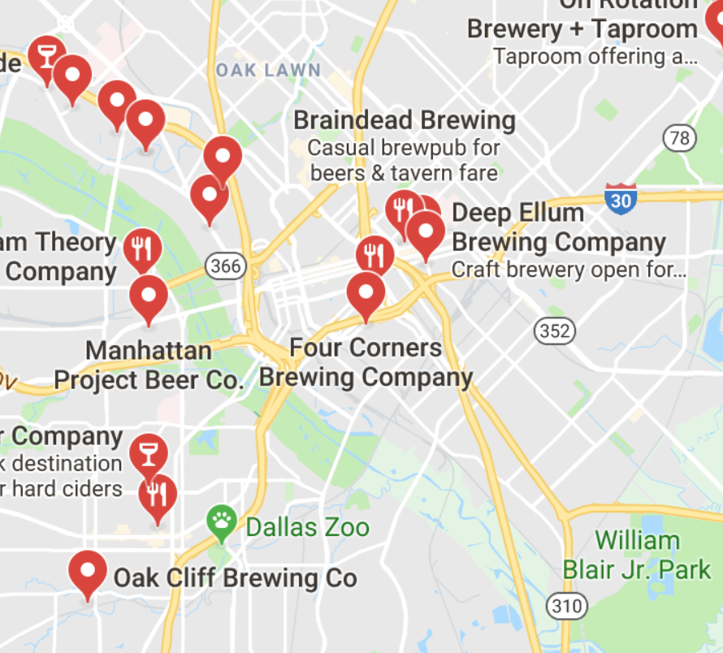
Breweries we targeted
Community Beer Company
Four Corners Brewing Company
Deep Ellum Brewing Company
BrainDead Brewing
Noble Rey Brewing Company
Texas Ale Project
Peticolas Brewing Company
https://maps.google.com

Slide 9
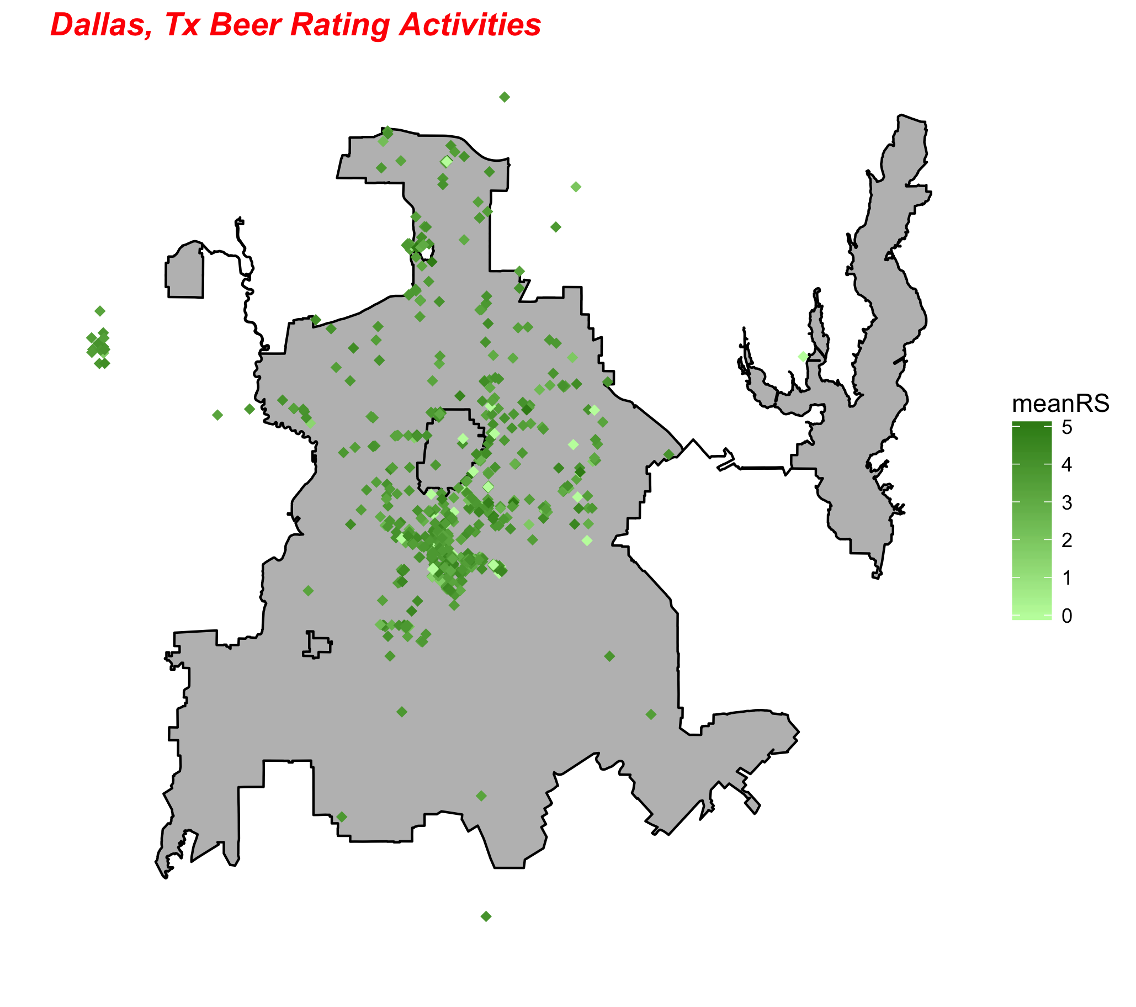

Slide 10
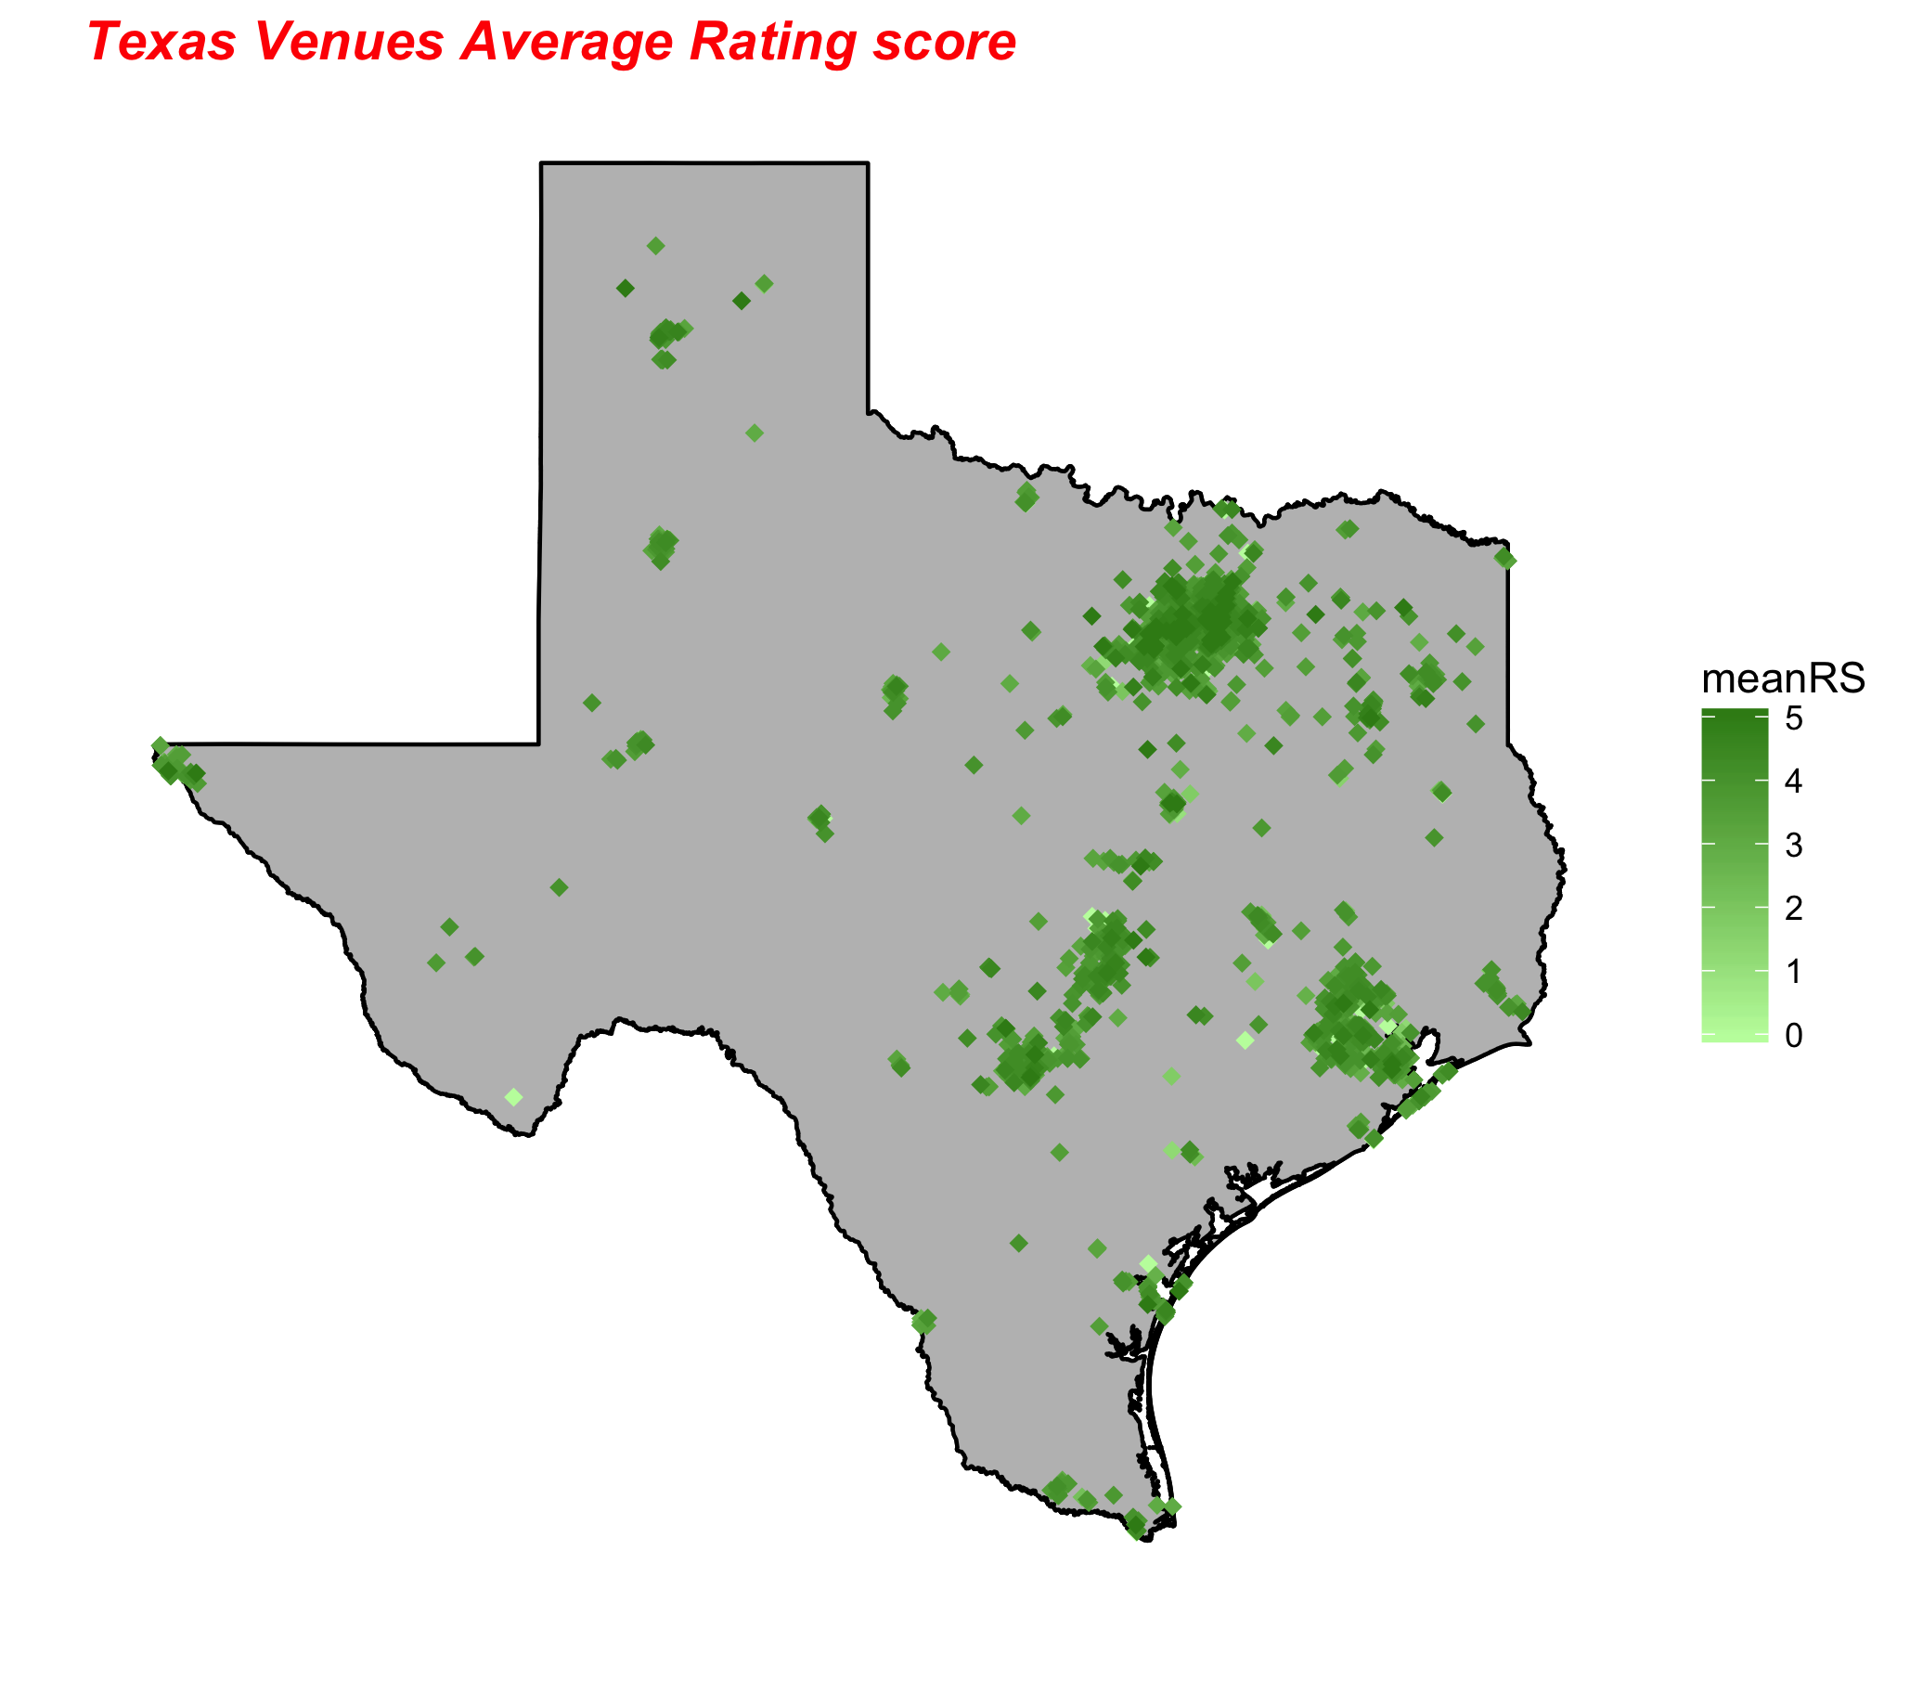

Slide 11
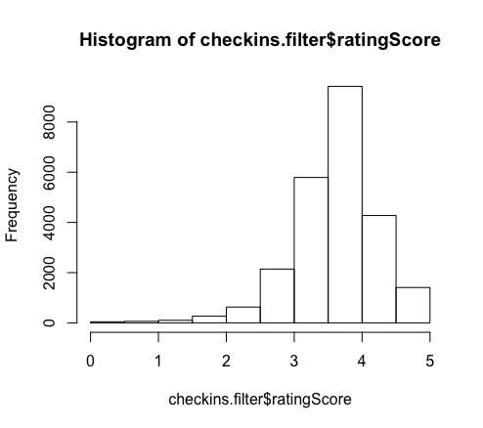
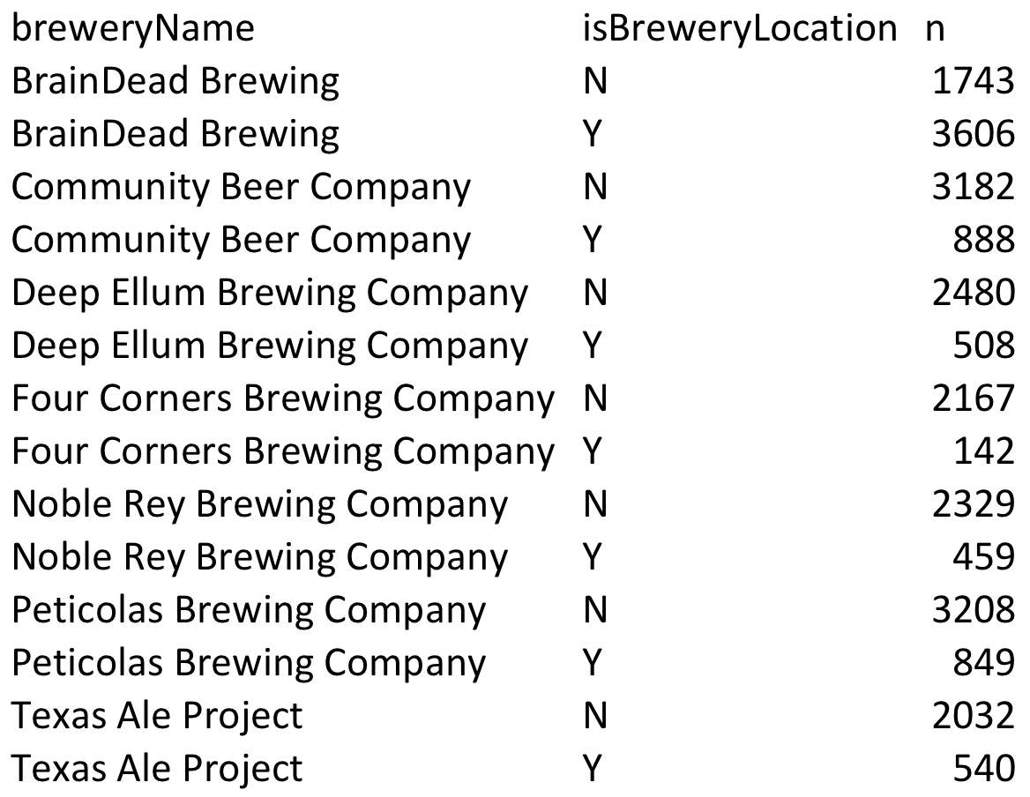
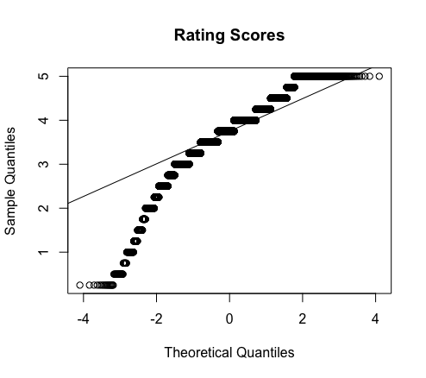
Is beer really better at the brewery?
Notes:
The data appears to have a right skewness, however given its large sample size CLT will be robust from violations.
User can check in the same beer multiple time in multiple locations, in order to account for independenct we will average the users rating based on location; at brewery / not at brewery.

Slide 12
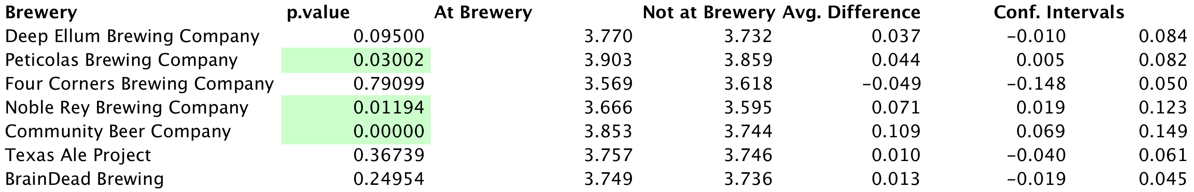
Conclusion
3 of the 7 breweries were statistically conclusive
Confounding variables
Limited population
*Full test can be found on our github repository: LocationBias.Rmd
Notes:
At a significant level of .05, Peticolas, Nobel Rey, and Community mean rating is greater while consumed at the brewery versus not at the brewery. A 95% confident intervals are listed above.
The average differences are small and we will need to research additional confounding variables to be imply any real changes; such as beer styles and person preferences.
This was an observational study thus no casual inferrence can be made from the study. The data was consumed from one week worth of 300 check-ins per beer and not a random sample. We can only generalize from this population.

Slide 14
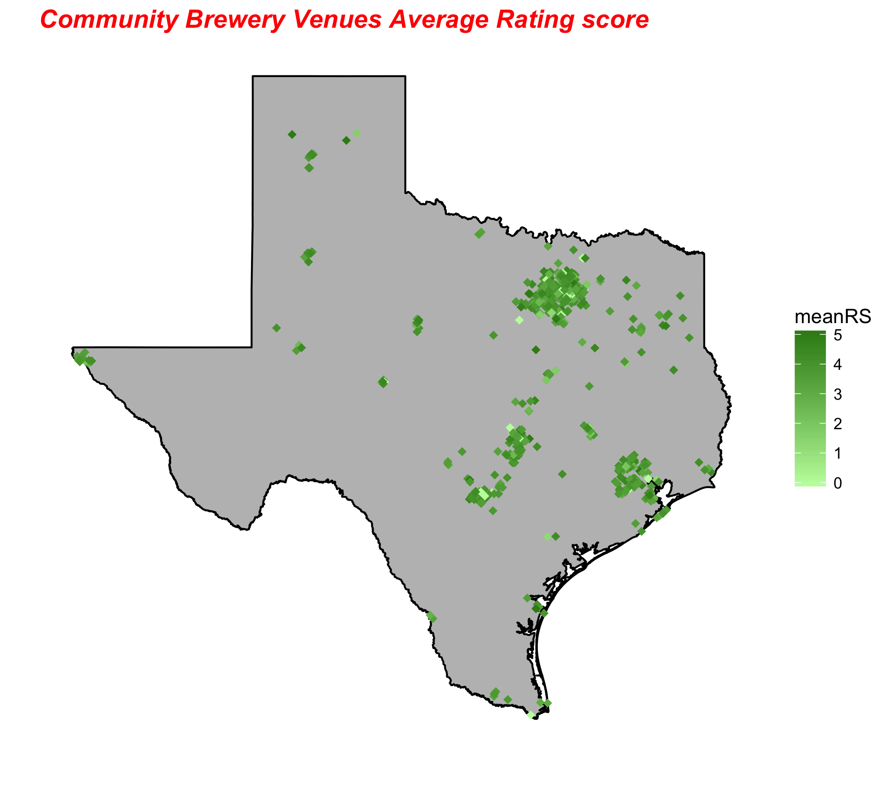

Slide 15
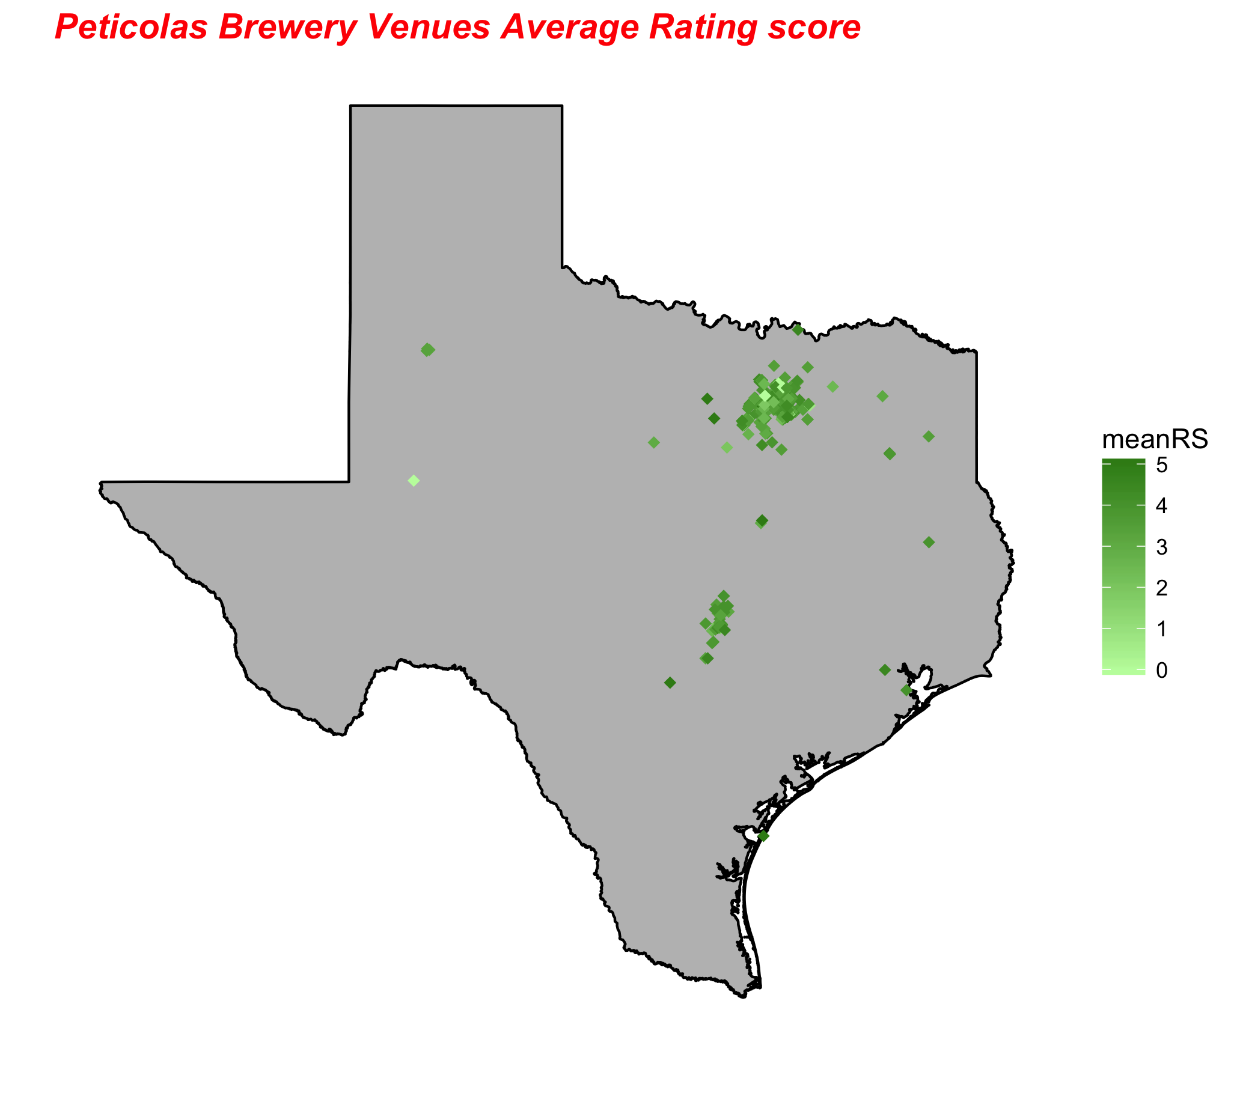

Slide 16
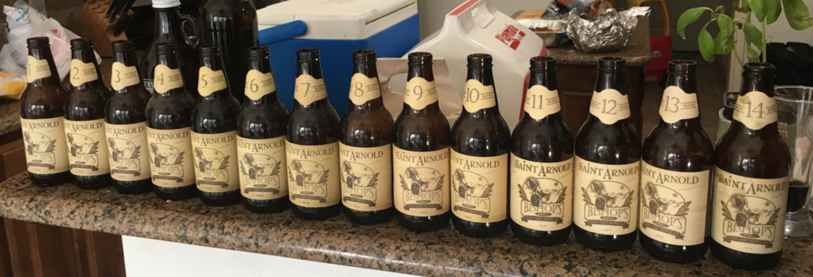
We need more data!
Notes:
More data is required
Include Beer Styles, IBU, ABV
Identify type of venue
Determine users taste preference

Slide 17
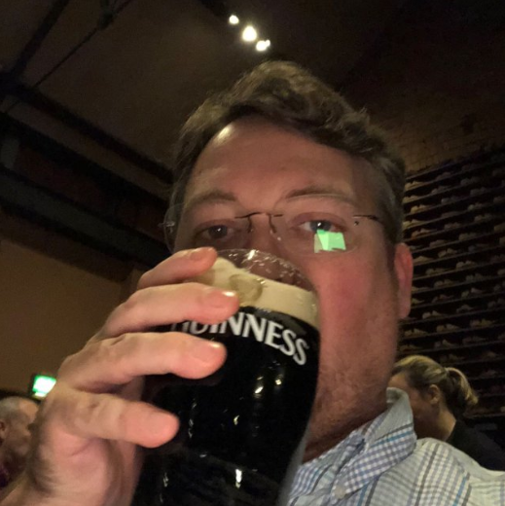
2. Beer me!
https://untappd.com/user/Chrisballenger/checkin/554483926

Slide 18
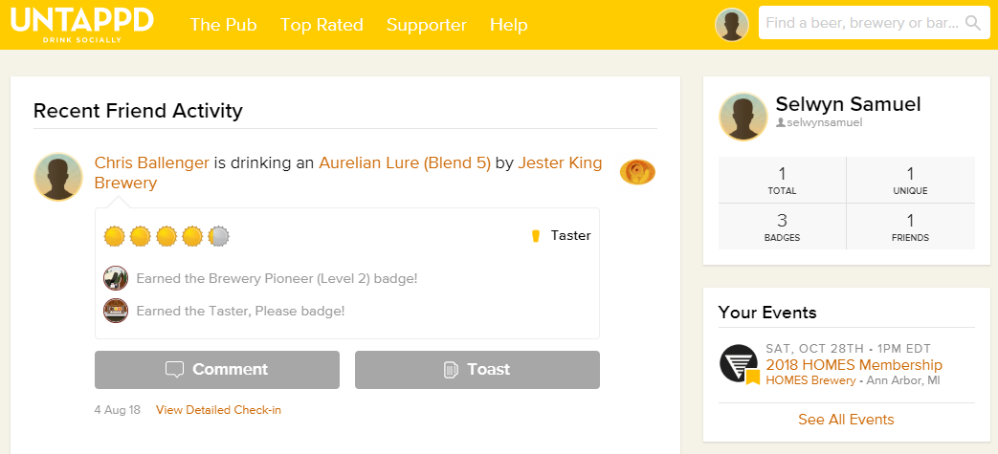


Data Gathering
Get JSON Objects using API
Keep record of max id for paginations
Extract data from JSON to data frames on Beer, Breweries, Check-ins
Enable the flag to denote if the location is the brewery or not
API
Challenges
Long API Client approval process
100 Calls per hour restriction
Merge data frames to master data frame
Write the data frame to CSV file for Master Check-ins
Source: https://untappd.com/

Slide 19
Beer Recommendation - Data Gathering
5 Users, 300+ check-ins, 1500 observations
1100 beer details
rvest & Rselenium packages, CSS Selector
Tricky show more logic
HTML parse -> data frame -> CSV files
Web Scraping
Challenges
IP Black-listed – Intelligent Proxies
Throttle http calls
Master User Profile
Master Beer Details
Source: https://untappd.com/

Slide 20
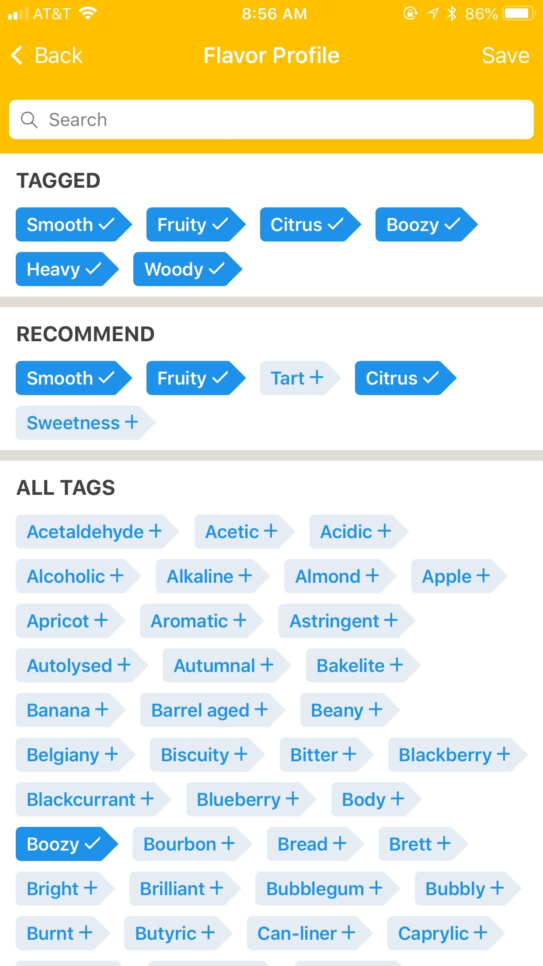
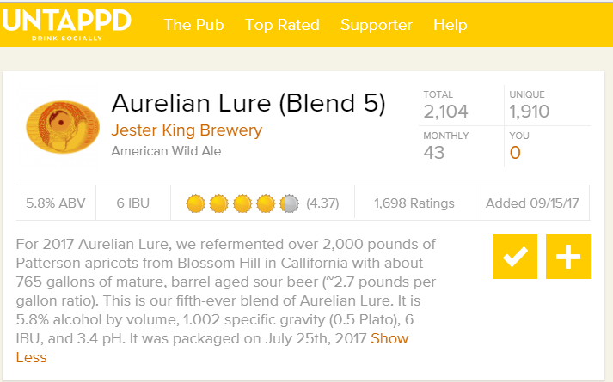
Beer Recommendation - Feature Selection
User selects flavors of a beer while checking in
Chose 40 out of the 100+ flavors to define a beer
Extract flavor keywords from beer description
Add beer features like ABV, IBU
ABV, IBU, Style, Light, Smooth, Clean, Sweet, Woody, Zippy, Strong, Hoppy, Floral, Citrus, Milk, Dark, Creamy, Mouthfeel, Soft, Boozy, Caramel, Oatmeal, Dry, Malty, Piney, Grassy, Tart, Sour, Salty, Fruity, Heat, Bitter, Coffee, Roasty, Chocolate, Juicy, Funky, Acidic, Crushable, User Name
Beer description
Check-in Flavor Profile
Source: https://untappd.com/

Slide 21
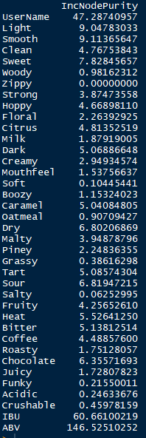
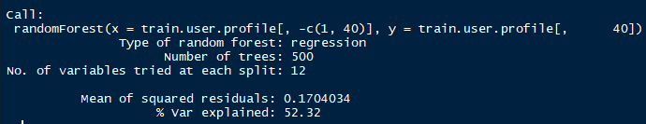
Beer Recommendation - Modeling
Random Forest – First Iteration
1555 Observations, 40 Features
80% training data, 20% testing data
Ratings – Ordinal 1 to 5 with 0.25 increments
Results/Challenges
Prediction rating was continuous (3.54, etc.,)
% var explained: 52.41 – Not very good
Mean Squared Residuals – 0.1704
Beer flavor features were not useful as they were not populated enough to have an impact on the ratings

Slide 22
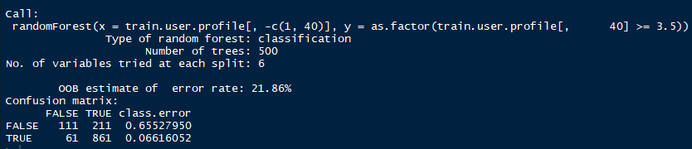
Beer Recommendation - Modeling
Random Forest – Second Iteration
1555 Observations, 40 Features
80% training data, 20% testing data
Ratings – 3.5 above – ThumsUp, else ThumsDown
Results

Slide 23
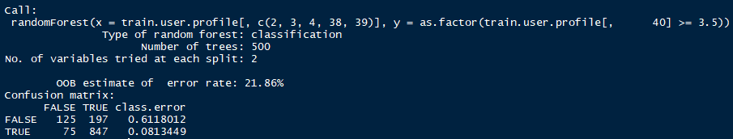
Beer Recommendation - Modeling
Random Forest – Third Iteration
1555 Observations, Top 5 Features
80% training data, 20% testing data
Ratings – 3.5 above – ThumsUp, else ThumsDown
Results

Slide 24
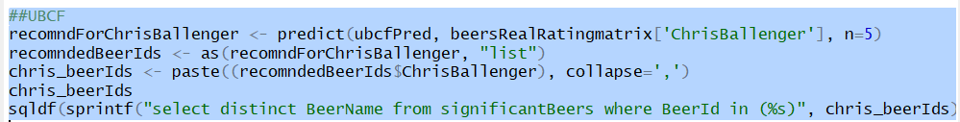
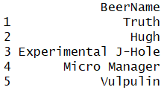
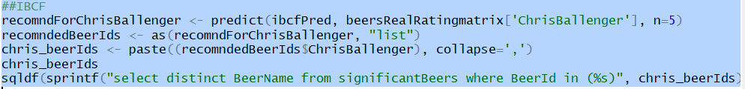
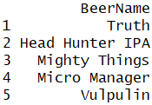
Beer Recommendation - Algorithms
recommenderlab – R Package for Recommender Algorithms
Collaborative filtering algorithms: Memory-based and Model-based methods.
Memory-based : Simply memorize all ratings and make recommendations based on relation between user-item and rest of the matrix (UBCF, IBCF)
Results

Slide 25
Conclusion
Flavor profile features were not fully utilized by the model and their importance were low
Need to understand more about tuning RandomForest
Try other algorithms and packages like recommenderlab and H₂O

Slide 26
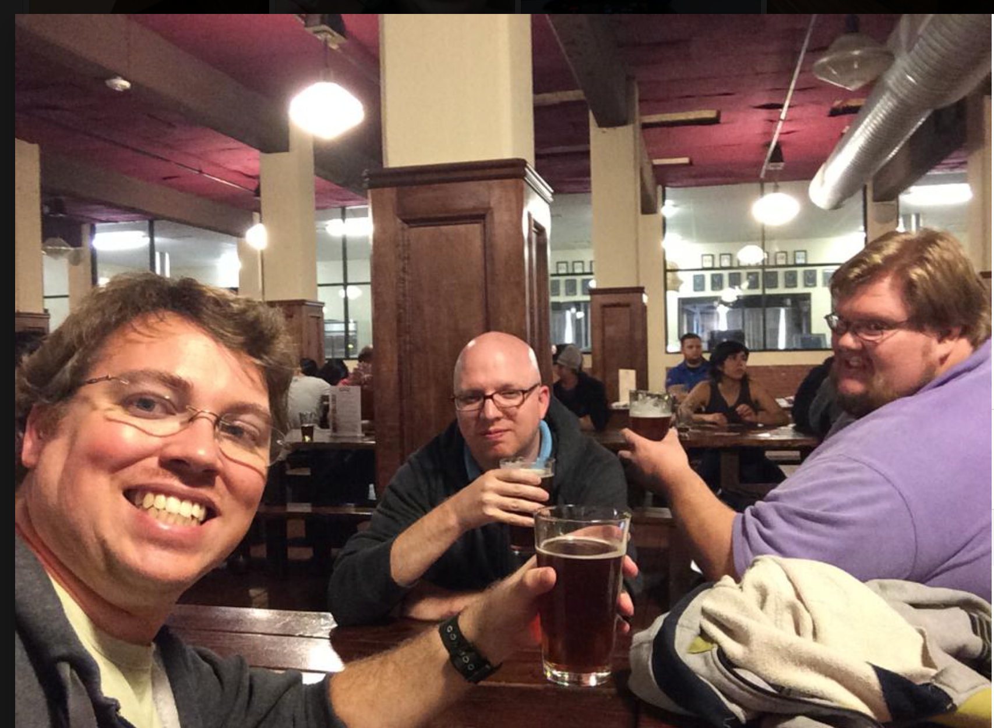
Cheers!

